Slide 1

Vel Tech Rangarajan Dr. Sagunthala R&D Institute of Science and Technology
School of Computing
Department of Computer Science and Engineering
10211CS224 / FULL STACK APPLICATION DEVELOPMENT (JAVA)
PROJECT REVIEW : MILESTONE PROJECT – 1
Date: 25-03-2026
Automated Quiz Engine with PDF Certification Generation
SDG: SDG 4 – Quality Education
Presented By:
D.SAHITHYA – VTU25983 – 23UECS0164
Courses Handling Faculty:
Dr. S . HEMAMALINI – M.E., Ph.D

Slide 2
INTRODUCTION
In the digital education era, online assessments are becoming increasingly important.
Many institutions still rely on manual quiz evaluation and certificate preparation.
This consumes time and increases the chances of human errors.
There is a need for an automated system to conduct quizzes efficiently.
An automated quiz engine can evaluate answers instantly.
Generating certificates manually is also time-consuming.
This project provides a complete automated solution for quizzes and certification.
It enhances learning experience with fast evaluation and instant PDF certificate generation.
1
2
3
4
5
6
7
8
9

Slide 3

PROBLEM STATEMENT
Many existing quiz systems require manual correction and certificate preparation.
This leads to delays in result publication and certificate distribution.
Manual systems are prone to errors and data mismanagement.
There is no centralized system to manage quiz records and certifications.
Institutions face difficulty in maintaining performance records.
Students expect quick results and digital certificates.
Hence, there is a need for a reliable automated quiz and certification system.
The system should ensure accuracy, speed, and secure data handling.
1
2
3
4
5
6
7
8
9

Slide 4
OBJECTIVE(S)
To design and develop an automated quiz engine with instant evaluation.
To implement automatic PDF certificate generation for successful candidates.
1
2
3
4
5
6
7
8
9

Slide 5
PROPOSED SYSTEM
Users can register and log in securely.
Admin can create and manage quizzes dynamically.
Questions are stored and retrieved from the database.
The system evaluates answers automatically.
Scores are calculated instantly after submission.
Qualified users receive auto-generated PDF certificates.
All records are securely stored in the database.
The system reduces manual work and improves efficiency.
1
2
3
4
5
6
7
8
9

Slide 6
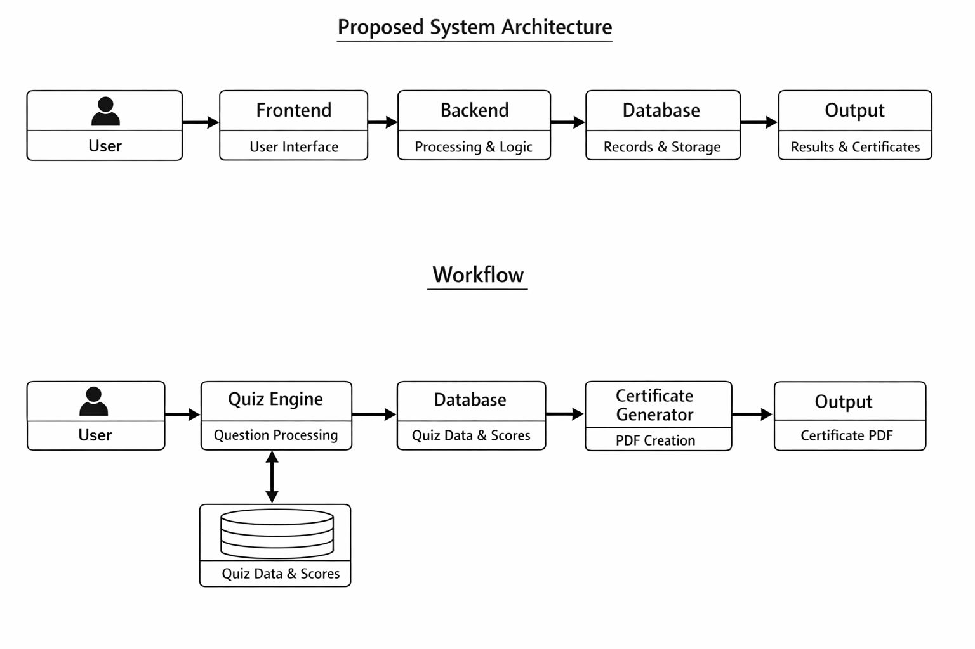
PROPOSED SYSTEM ARCHITECTURE
Explanation:
Input: User registration details, quiz answers, admin question entries.
Processing: Authentication, answer validation, score calculation, certificate generation.
Database: Stores user data, quiz questions, scores, and certificate records.
Output: Quiz results, score display, downloadable PDF certificate.
1
2
3
4
5
6
7
8
9

Slide 7
WORKFLOW
1
2
3
4
5
6
7
8
9

Slide 8
TECHNOLOGIES USED
Frontend: HTML, CSS
Backend: JavaScript
Database: MySQL
Tools: VS Code
Hardware Requirements: Minimum 4GB RAM, i3 Processor
Software Requirements: JDK 8+, MySQL Server, Web Browser
1
2
3
4
5
6
7
8
9

Slide 9
MODULE DESCRIPTION
Module 1: User Management
Handles user registration, login, authentication, and profile management.
Module 2: Quiz Management
Admin creates, updates, and deletes quiz questions and sets difficulty levels.
Module 3: Evaluation Engine
Automatically checks answers and calculates scores instantly.
Module 4: PDF Certification Module
Generates personalized PDF certificates with user name, score, and date.
1
2
3
4
5
6
7
8
9

Slide 10
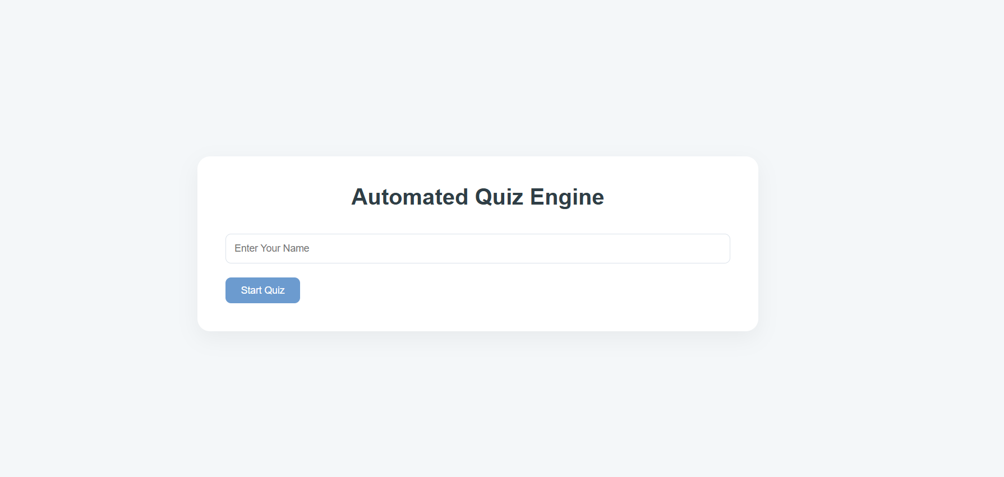
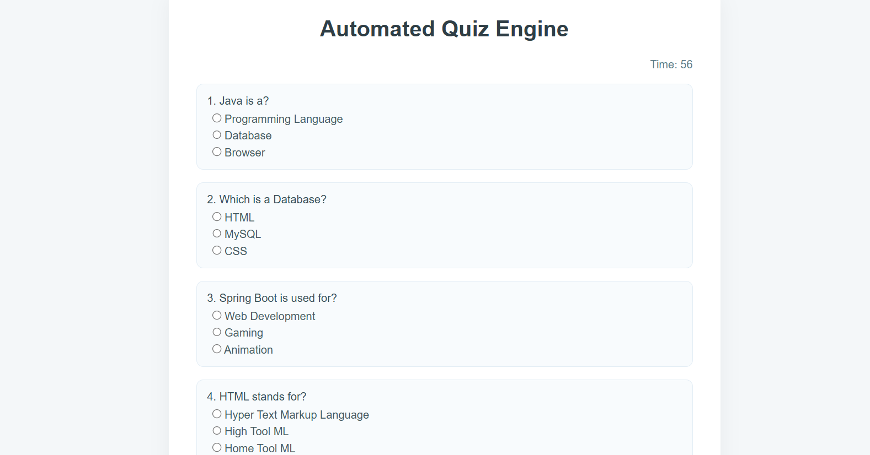
IMPLEMENTATION SCREENSHOTS
Home Page: Displays project title.
Main Quiz Page: Displays multiple-choice questions and timer .
1
2
3
4
5
6
7
8(A)
9

Slide 11
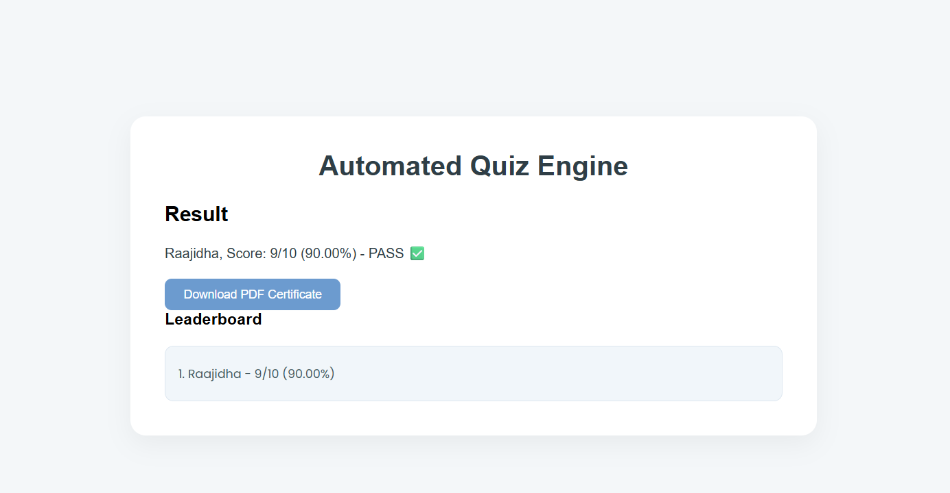
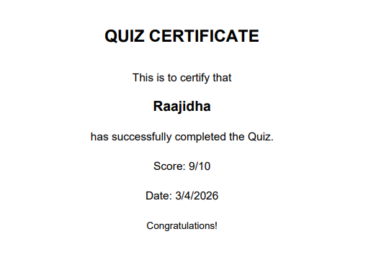
IMPLEMENTATION SCREENSHOTS
Result Page: Shows total score and qualification status instantly after submission.
Certificate Page: Displays downloadable PDF certificate for qualified users.
1
2
3
4
5
6
7
8(B)
9

Slide 12
ADVANTAGES & LIMITATIONS
Advantages:
Reduces manual effort
Instant evaluation and result generation
Automatic PDF certificate creation
Secure data storage
User-friendly interface
Limitations:
Requires internet connection
Limited to objective-type questions
Initial setup and maintenance required
1
2
3
4
5
6
7
8
9

Slide 13
Thank you

